Slide 1
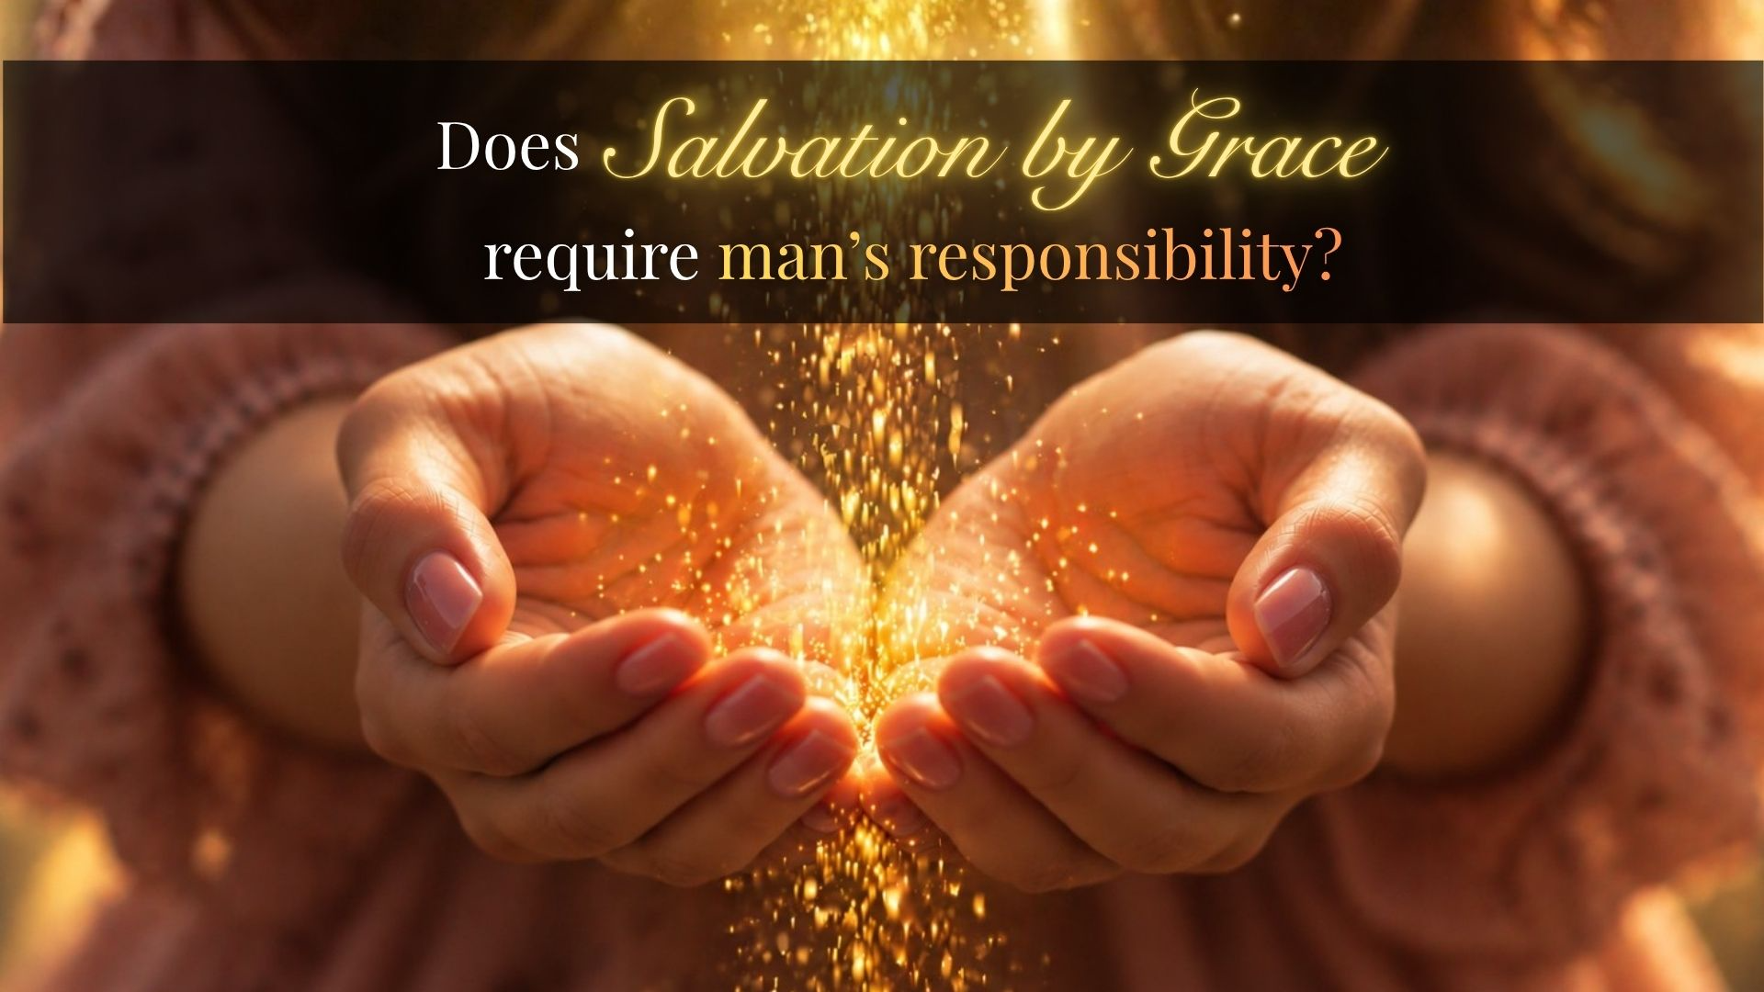
Does Salvation by grace require man's responsibility?
Date: 1 November 2026

Slide 2
Worthy (Philippians 1:27)
Axios”:
fitting, suitable, appropriate, properly
Comparable,
of similar weight or value
The question is, not simply, what must I do?
Or even,what is it that God has done for me. But,
what is the value of this thing?
Who have I become? What am I now?
Where am I” who am I under?

Slide 3
Ephesians 2. God’s Handiwork
Read response
you were dead in …at work in those who are disobedient.
3 All of us also lived among them …and following its desires and thoughts.
Like the rest, …deserving of wrath.
4 But because of his great love …it is by grace you have been saved.
10 For we are God’s handiwork…

Slide 4

Ephesians 2. God’s temple
built on the foundation of the apostles and prophets,
with Christ Jesus himself as the chief cornerstone.
21 In him the whole building is joined together and
rises to become a holy temple in the Lord.
22 And in him you too are being built together
to become a dwelling in which God lives by his Spirit

Slide 5
Romans 6. Questions
1 What shall we say, then? Shall we go on sinning so that grace may increase? 2 By no means! | 15 What then? Shall we sin because we are not under the law but under grace? By no means!

Slide 6
Premise a foundational truth, used as a basis for logical argument
1What shall we say, then? Shall we go on sinning so that grace may increase? 2 By no means! | 15 What then? Shall we sin because we are not under the law but under grace? By no means!
We are those who have died to sin; how can we live in it any longer? 3 Or don’t you know that all of us who were baptized into Christ Jesus were baptized into his death? | 16 Don’t you know that when you offer yourselves to someone as obedient slaves, you are slaves of the one you obey— whether you are slaves to sin, which leads to death, or to obedience, which leads to righteousness?

Slide 7
For what? So what? I am what? (purpose, implication, identity)
Shall we go on sinning so that grace may increase? 2 By no means! | Shall we sin because we are not under the law but under grace? By no means!
We are those who have died to sin; how can we live in it any longer? 3 Or don’t you know that all of us who were baptized into Christ Jesus were baptized into his death? | 16 Don’t you know that when you offer yourselves to someone as obedient slaves, you are slaves of the one you obey— whether you are slaves to sin, which leads to death, or to obedience, which leads to righteousness?
just as Christ was raised from the dead through the glory of the Father, we too may live a new life. [FUTURE] 5 For if we have been united with him in a death like his, we will certainly also be united with him in a resurrection like his. | [changed allegiance] 17 But thanks be to God that, though you used to be slaves to sin, you have come to obey from your heart the pattern of teaching that has now claimed your allegiance. 18 You have been set free from sin and have become slaves to righteousness.

Slide 8
Conclusion. Romans 6:13
12 Therefore do not let sin reign in your mortal body so that you obey its evil
desires.
13 Do not offer any part of yourself to sin as
an instrument of wickedness,
but rather offer yourselves to God
as those who have been brought from death to life;
and offer every part of yourself to him as
an instrument of righteousness.
Notes:
Who uses hoopla?
Hoplites.
In ancient Greece (primarily from the 7th to 4th centuries BCE), hopla was used by hoplites—heavily armed infantrymen who fought in dense phalanx formations.
Hoplites video
Hoplites:
Time
0 to 1.08 (…use their weapons)
1.55 to 5.25 (according to Homer’s Iliad… [to end])

Slide 9

