Slide 1
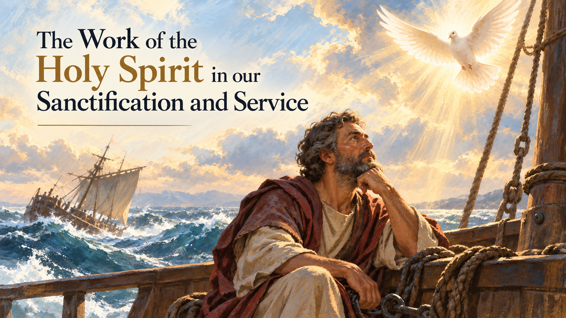

Slide 2
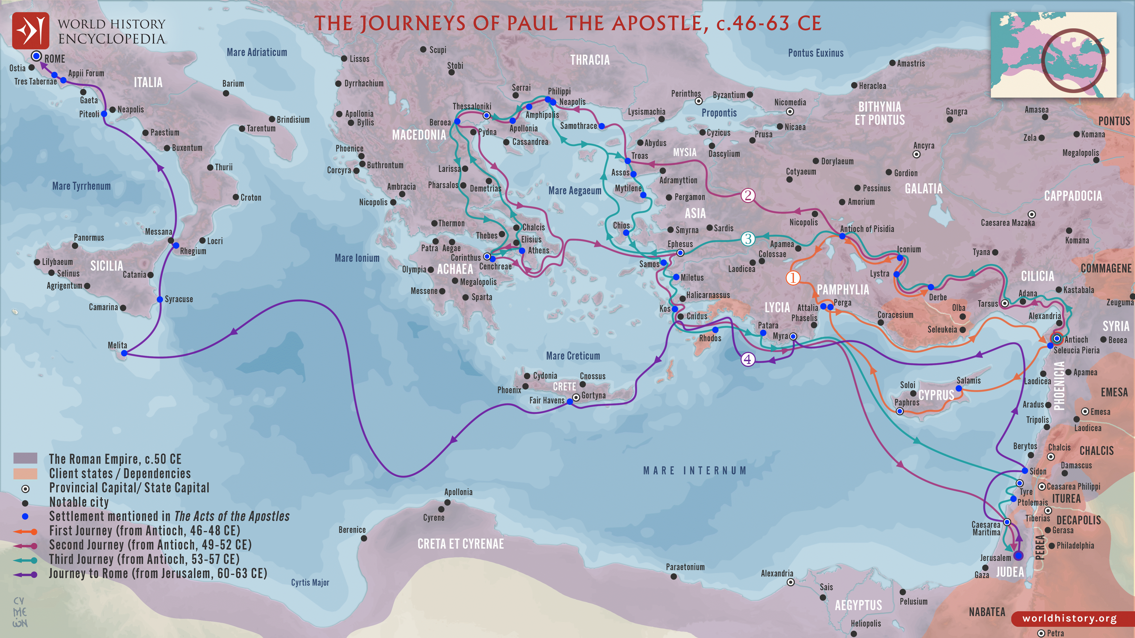
Rome
Puteoli
Rhegium
Syracuse
Cnidus
Myra
Malta
Fair Havens
Sidon
Caesarea
Jerusalem

Slide 3

God’s Promise:
“the Lord stood near Paul and said: “Take courage! As you have testified about me in Jerusalem, so you must also testify in Rome.” Acts 23:11

Slide 4

Trusting God in His deliverance during a crisis

Slide 5
Spiritual discernment in impending danger

Slide 6
Foresight and credibility before crisis

Slide 7
“Before very long, a wind of hurricane force, called the Northeaster, swept down from the island.”
Acts 27:14
“When neither sun nor stars appeared for many days and the storm continued raging, we finally gave up all hope of being saved.”
Acts 27:20

Slide 8
“Men, you should have taken my advice ….
Acts 27:21

Slide 9
Foresight and credibility before crisis

Slide 10
Testify of personal faith in God
But now I urge you to keep up your courage, because not one of you will be lost... Last night an angel of the God to whom I belong and whom I serve stood beside me and said, ‘Do not be afraid, Paul...’ So keep up your courage, men, for I have faith in God that it will happen just as He told me.” Acts 27:22-25

Slide 11
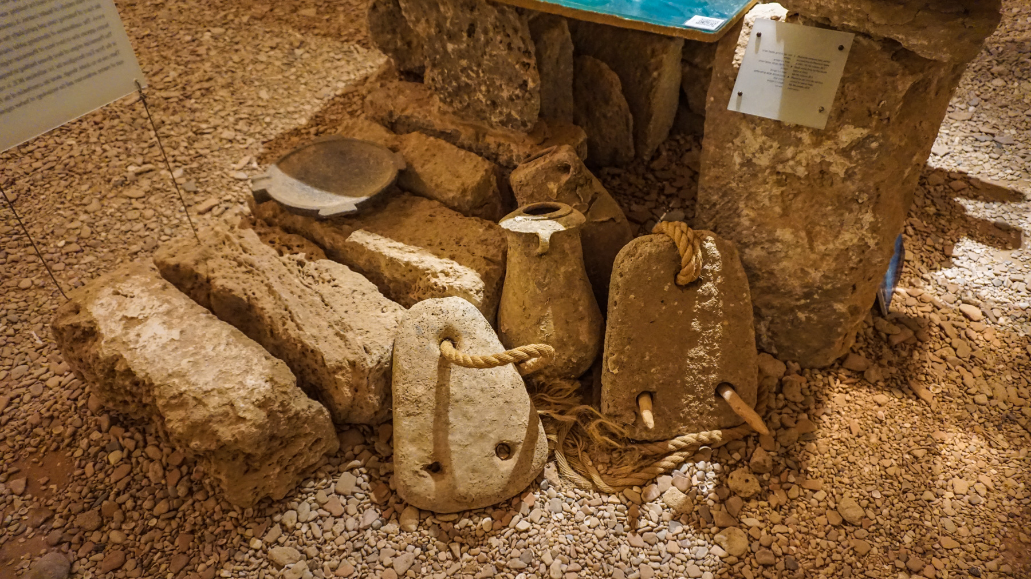

Slide 12
Compassion on the weary

Slide 13
Just before dawn Paul urged them all to eat. ‘For the last fourteen days,’ he said, ‘you have been in constant suspense and have gone without food – you haven’t eaten anything. Now I urge you to take some food. You need it to survive.’ ... he took some bread and gave thanks to God in front of them all. Acts 27:33-35

Slide 14
Counsel for survival

Slide 15
God's promise did not eliminate human responsibility. God promised the outcome, but they still had to obey.

Slide 16
Personal crisis is an opportunity for witnessing anywhere

Slide 17
“they will pick up snakes with their hands, and when they drink deadly poison, it will not hurt them at all; they will place their hands on sick people, and they will get well.”
Mark 16:18

Slide 18

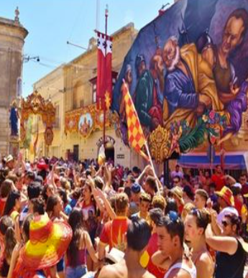
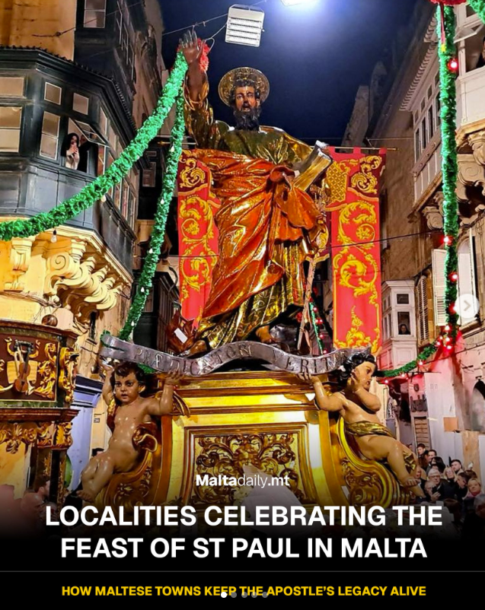
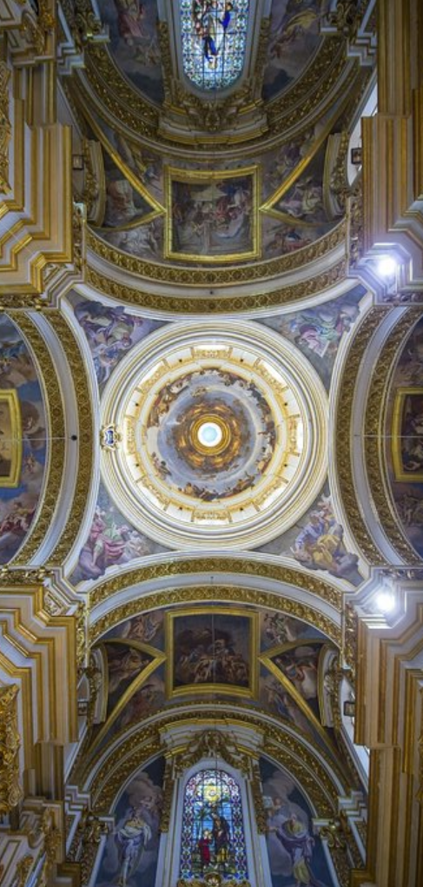
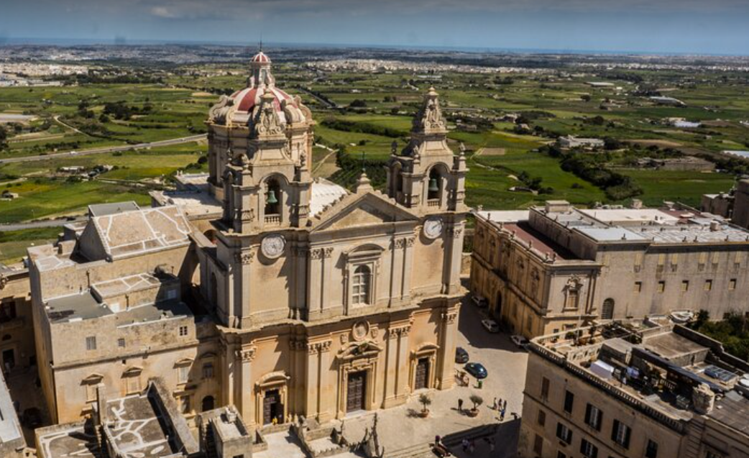
Feast of St Paul’s Shipwreck
and Mdina Cathedral

Slide 19
Consistency to Jesus’ mission
no matter where we are located

Slide 20
For two whole years Paul stayed there… (and) proclaimed the kingdom of God and taught about the Lord Jesus Christ – with all boldness and without hindrance!
Acts 28:30-31

Slide 21
Trusting God in His deliverance during a crisis
Spiritual discernment
Foresight and credibility
Testifying of personal faith in God
Having Compassion on the weary
Counsel for survival
Personal crisis as an opportunity to witness anywhere
Consistency to Jesus’ mission regardless of location or crisis

Slide 22
T – TRUST GOD
Trust God in the crisis.
R – RECOGNISE
Exercise spiritual discernment and foresight.
U – USE YOUR VOICE
Testify of your personal faith in God.
S – SERVE OTHERS
Have compassion and give counsel to those who are weary.
T – TESTIFY EVERYWHERE
See every crisis and every location as an opportunity to witness and remain faithful to Jesus' mission.

