Slide 1
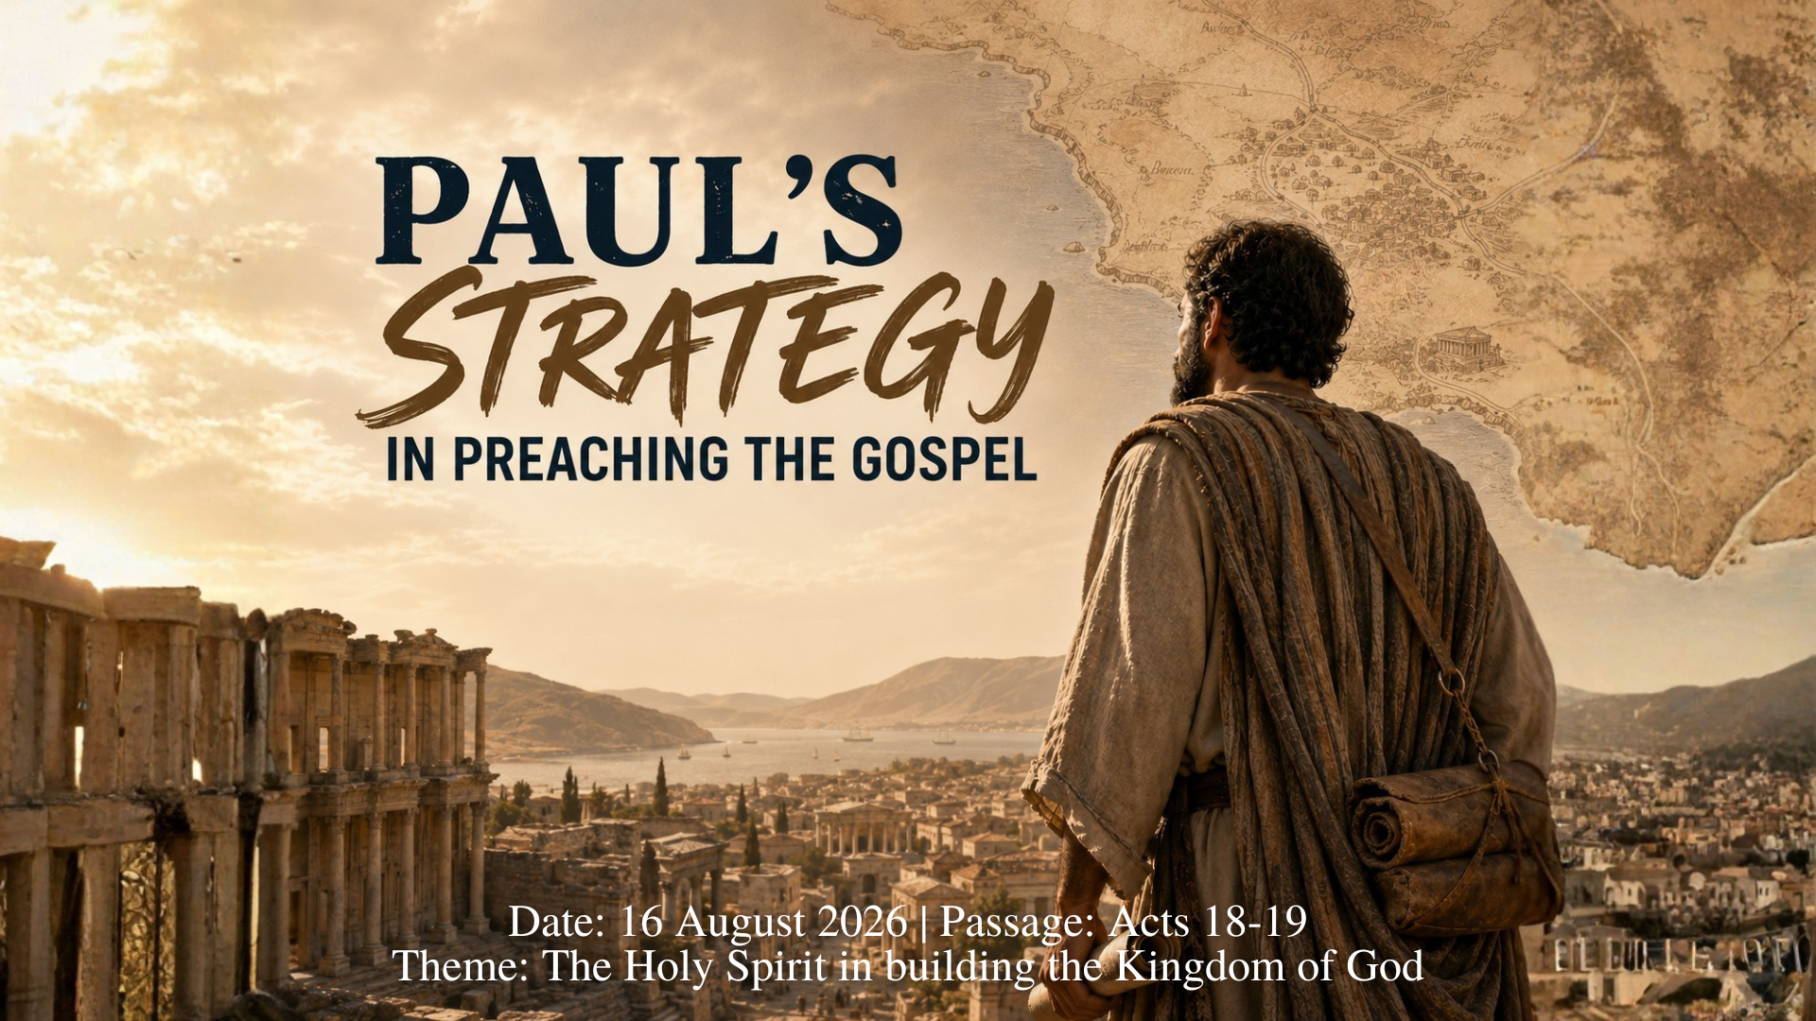

Slide 2
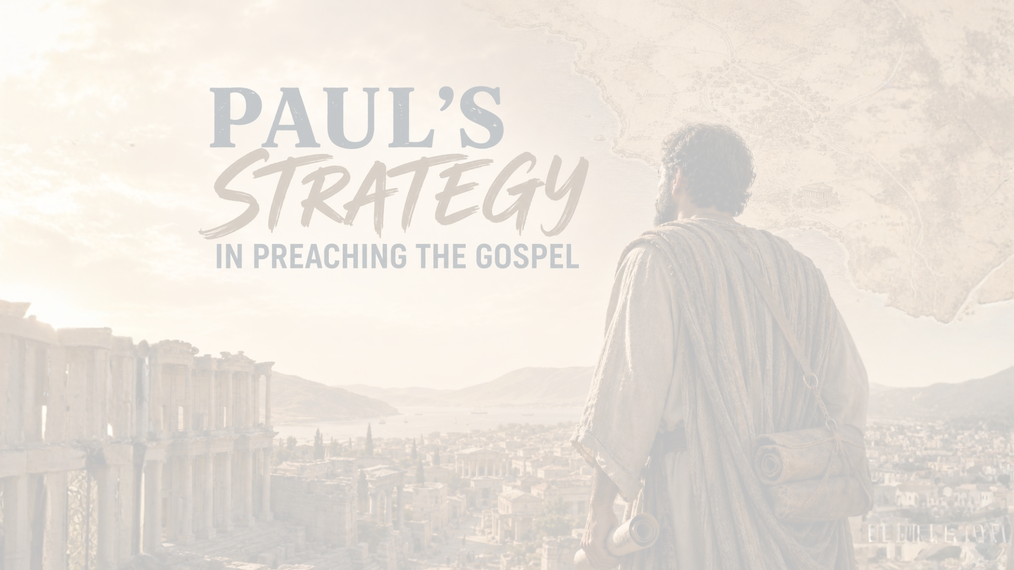
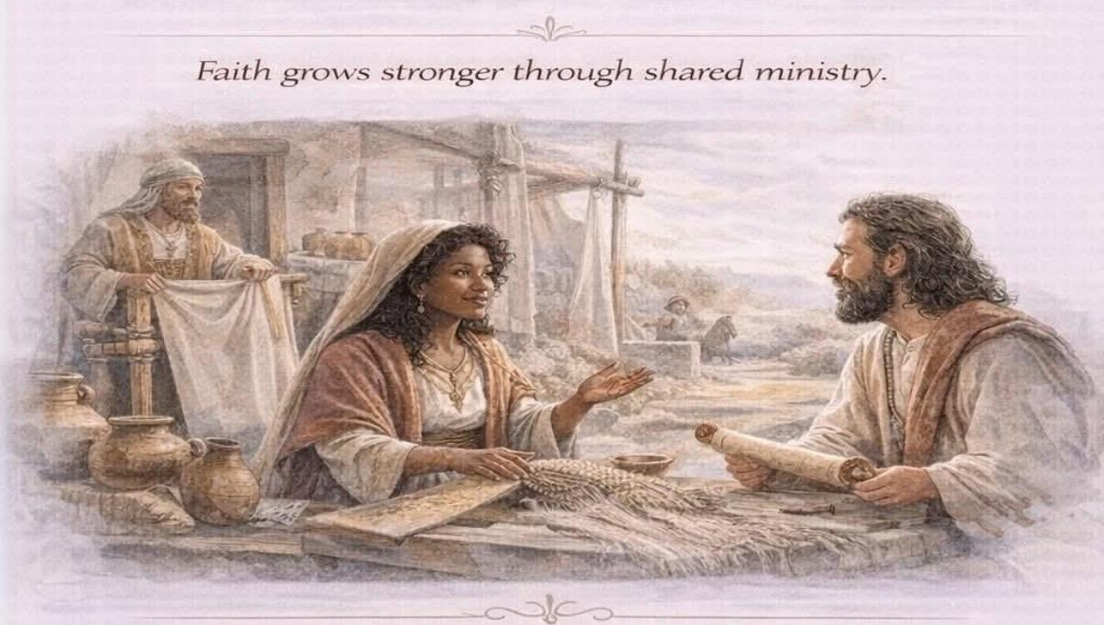
18:1-28
Paul witnesses to 3 groups:
1. Jews in the Synagogue
2. Gentiles in the Marketplace
3. Those in Idolatry & Darkness
The Word spreads through:
Faithful witnesses +
Spirit-empowered ministry +
God’s sovereign presence
INTRODUCTION
The Spirit empowers ordinary, faithful people
- Acts 18-19: A case study in unstoppable gospel advance

Slide 3
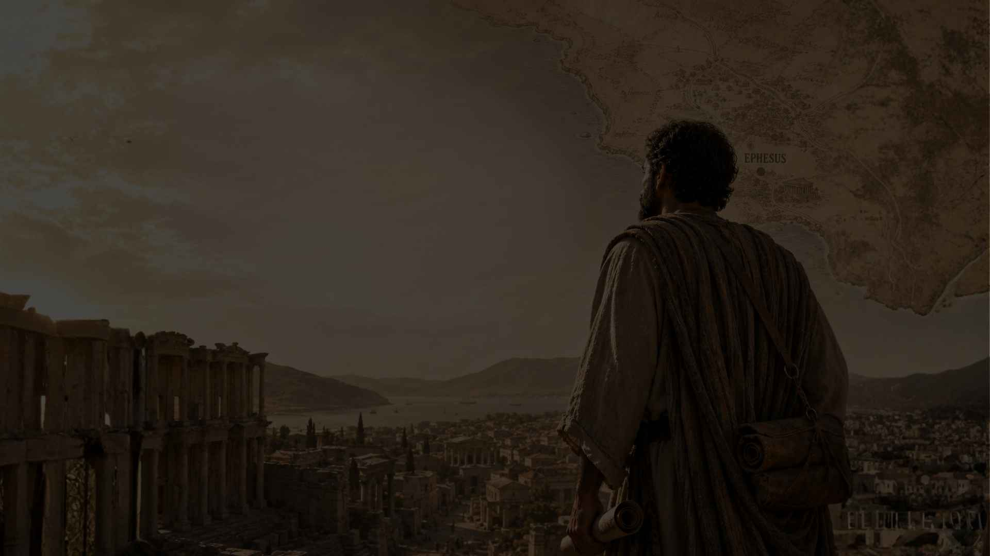
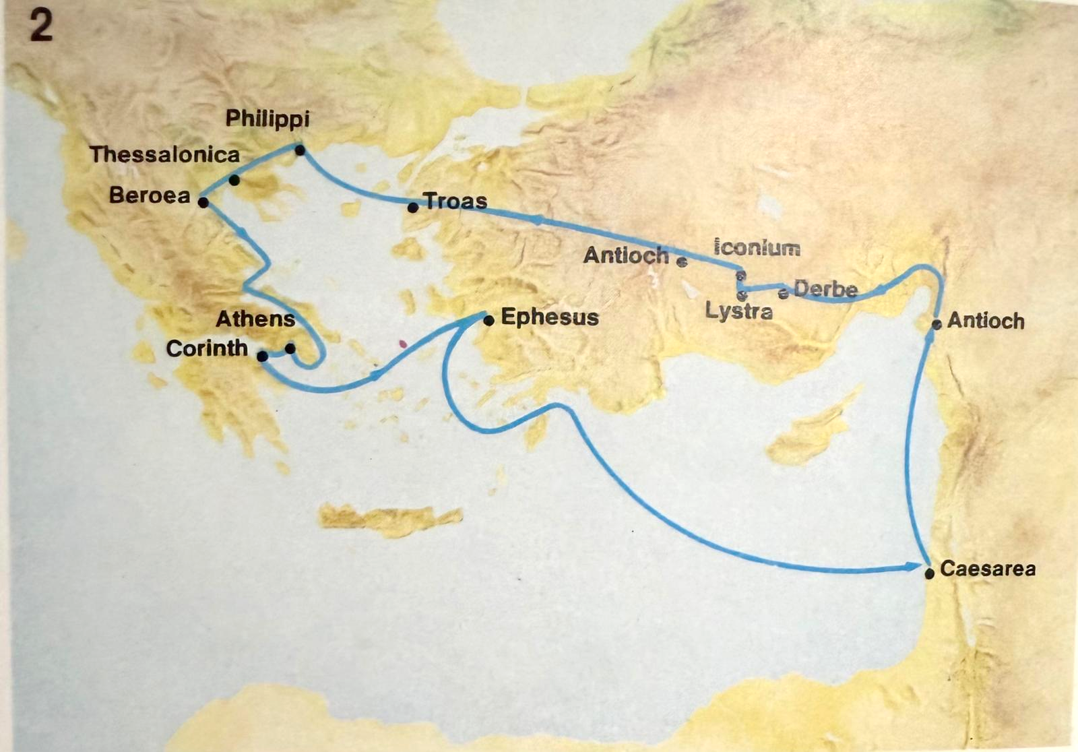
18 Paul stayed on in Corinth for some time. Then he left the brothers and sisters and sailed for Syria, accompanied by Priscilla and Aquila…
19 They arrived at Ephesus, where Paul left Priscilla and Aquila. He himself went into the synagogue and reasoned with the Jews.
21-22 … Then he set sail from Ephesus. When he landed at Caesarea, he went up to Jerusalem and greeted the church and then went down to Antioch.
^{Acts 18}
1 After this, Paul left Athens and went to Corinth.
2-4 There he met a Jew named Aquila, a native of Pontus, who had recently come from Italy with his wife Priscilla, because Claudius had ordered all Jews to leave Rome. Paul went to see them, and because he was a tentmaker as they were, he stayed and worked with them. Every Sabbath he reasoned in the synagogue, trying to persuade Jews and Greeks.
5-6 When Silas and Timothy came from Macedonia, Paul devoted himself exclusively to preaching, testifying to the Jews that Jesus was the Messiah. But when they opposed Paul and became abusive, he shook out his clothes in protest and said to them, “Your blood be on your own heads! I am innocent of it. From now on I will go to the Gentiles.”
7 Then Paul left the synagogue and went next door to the house of Titius Justus, a worshipper of God.
11 So Paul stayed in Corinth for a year and a half, teaching them the word of God.

Slide 4
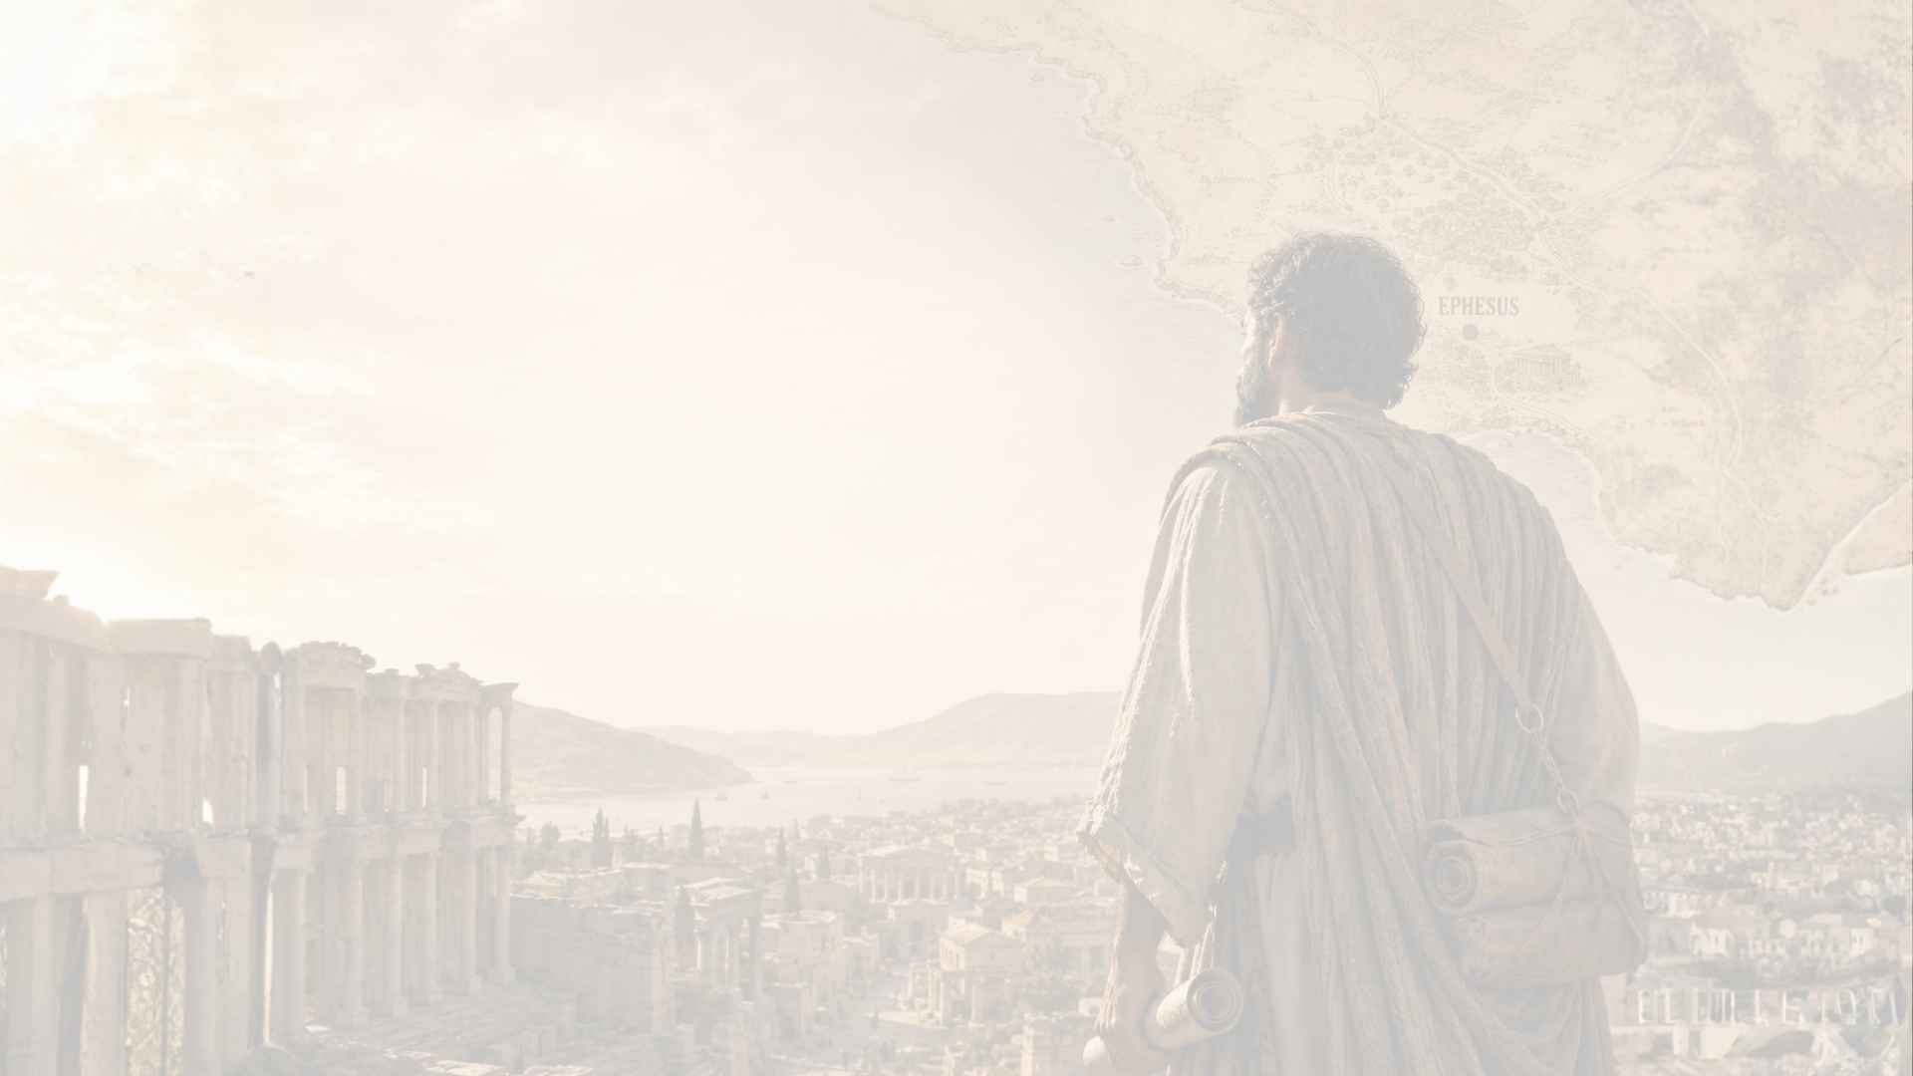
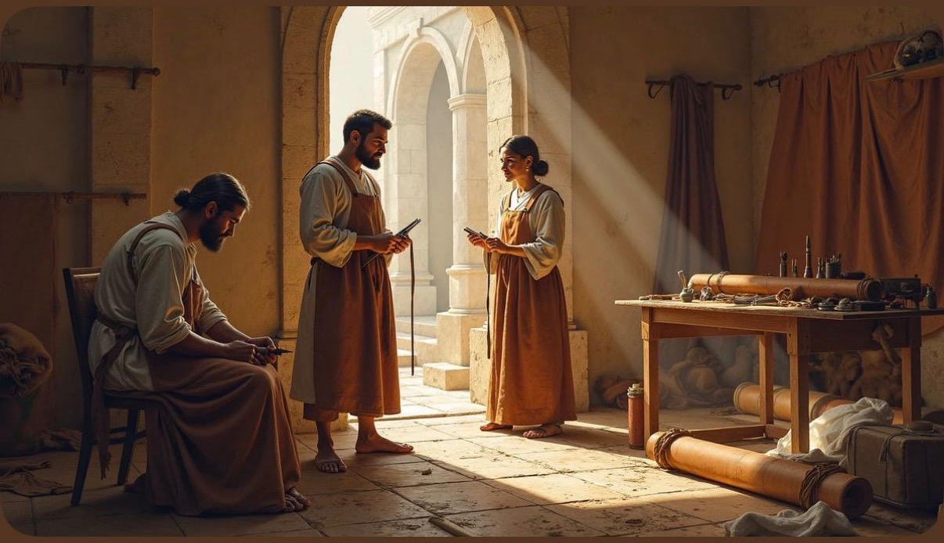
1. THE HOLY SPIRIT STRENGTHENS US FOR FAITHFUL WITNESS
START WHERE PEOPLE ARE - CORINTH
Paul: tentmaker with Aquila & Priscilla (Acts 18:1-3)
- With Silas & Timothy: devoted to preaching (Acts 18:5)
Lesson: God uses everyday jobs & relationships
- Ministry was never meant to be solo
4

Slide 5
(i) JEWS IN THE SYNAGOGUE Acts 18:4-8
Paul reasoned with them every Sabbath Acts 18:4
When opposed → went “next door” Acts 18:6-7
Lesson: Know when to pivot
Harvest: Crispus & household believed Acts 18:8
Lesson: Be faithful. Preach clearly. Trust God.

Slide 6
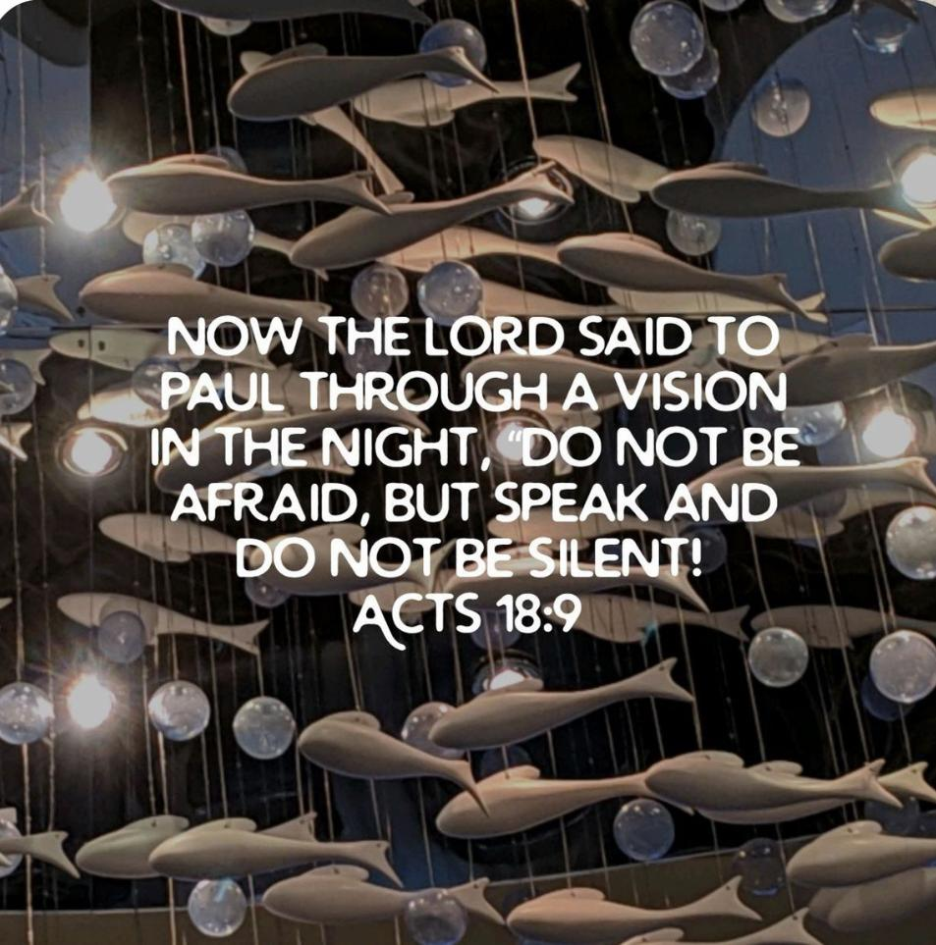
(ii) GENTILES IN THE MARKETPLACE Acts 18:9-17
- Stayed 18 months teaching Acts 18:11
- He laid a biblical foundation in a broken city
→Fruit: Phoebe, Gaius, Stephanas, Chloe... & many more
The Spirit strengthens us to keep speaking
6

Slide 7
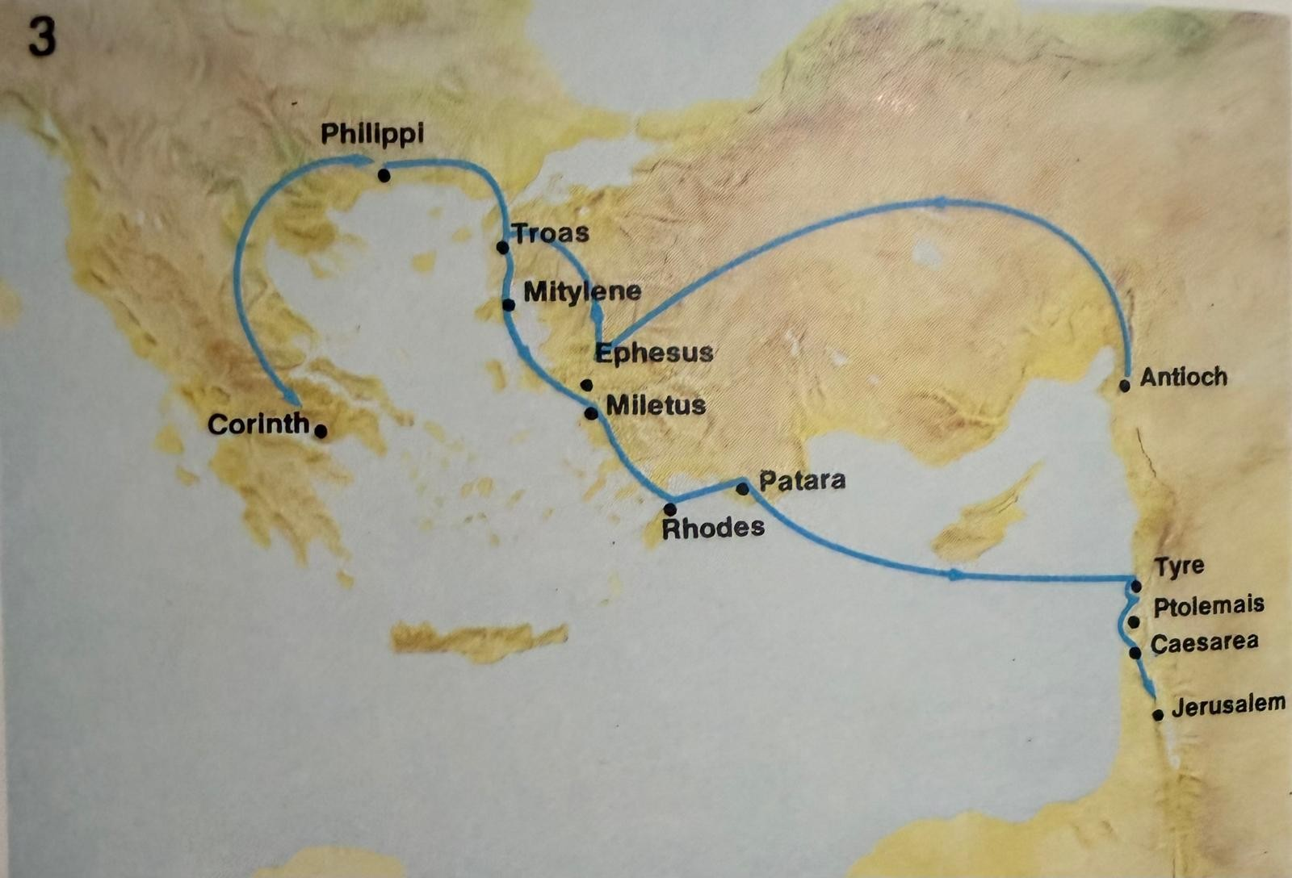
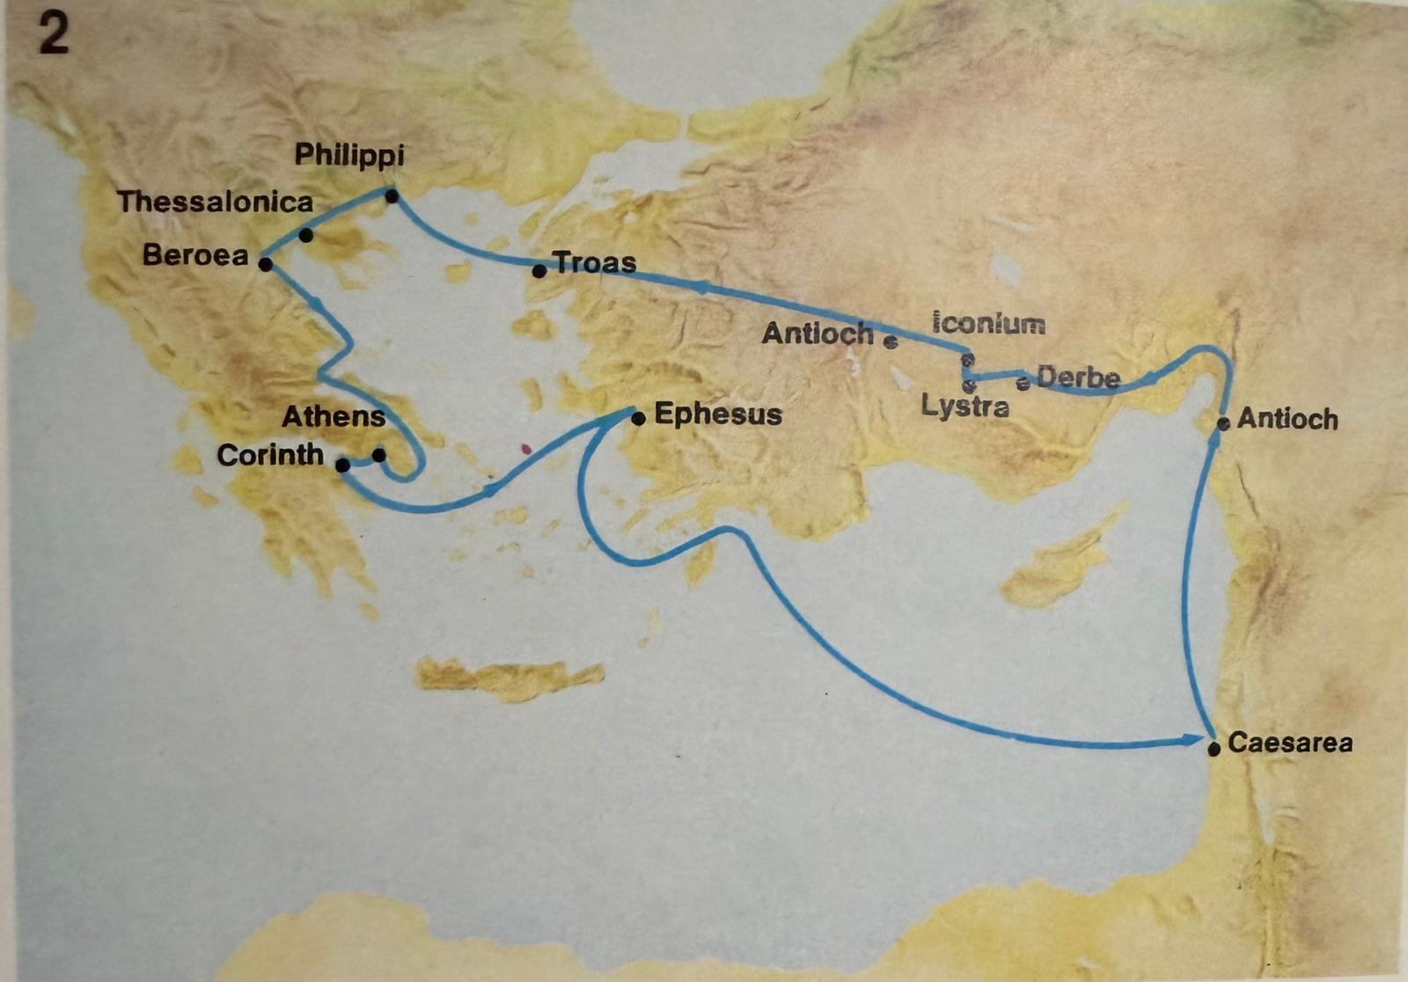
^{Acts 18}
23 After spending some time in Antioch, Paul set out from there and travelled from place to place throughout the region of Galatia and Phrygia, strengthening all the disciples.
^{Acts 19}
1… Paul took the road through the interior and arrived at Ephesus. There he found some disciples
^{Acts 18}
18 Paul stayed on in Corinth for some time. Then he left the brothers and sisters and sailed for Syria, accompanied by Priscilla and Aquila…
19 They arrived at Ephesus, where Paul left Priscilla and Aquila. He himself went into the synagogue and reasoned with the Jews.
21 … Then he set sail from Ephesus. 22 When he landed at Caesarea, he went up to Jerusalem and greeted the church and then went down to Antioch.
3rd Missionary Journey AD 53 - AD 56
2nd Missionary Journey AD 49 - AD 52
^{AD 53 - AD 55}
^{AD 51 - AD 52}
7

Slide 8
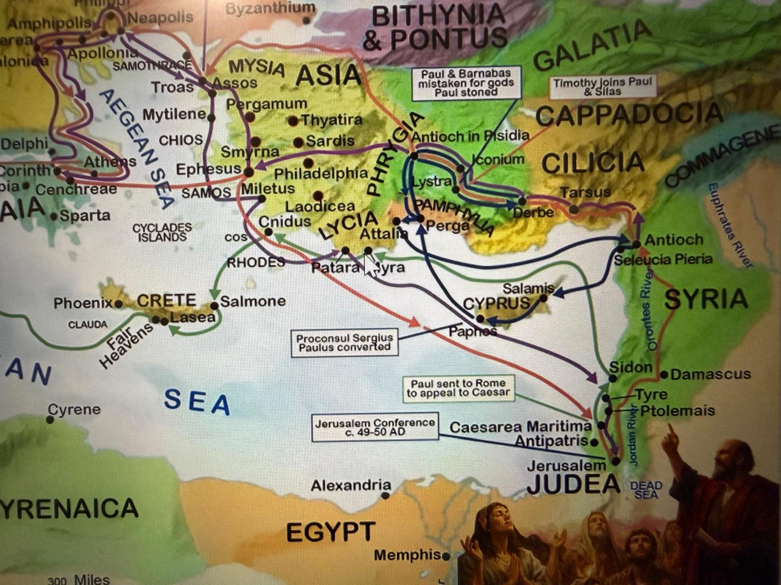
10 This went on for two years, so that all the Jews and Greeks who lived in the province of Asia heard the word of the Lord.
11 God did extraordinary miracles through Paul, 12 so that even handkerchiefs and aprons that had touched him were taken to the sick, and their illnesses were cured and the evil spirits left them.
20 In this way the word of the Lord spread widely and grew in power.
^{Acts 18}
23 After spending some time in Antioch, Paul set out from there and travelled from place to place throughout the region of Galatia and Phrygia, strengthening all the disciples.
^{Acts 19}
1… Paul took the road through the interior and arrived at Ephesus. There he found some disciples
2 and asked them, “Did you receive the Holy Spirit when you believed?” They answered, “No, we have not even heard that there is a Holy Spirit.”
6 When Paul placed his hands on them, the Holy Spirit came on them, and they spoke in tongues and prophesied. 7 There were about twelve men in all.
8 Paul entered the synagogue and spoke boldly there for three months, arguing persuasively about the kingdom of God. 9 But some of them became obstinate; they refused to believe and publicly maligned the Way. So Paul left them. He took the disciples with him and had discussions daily in the lecture hall of Tyrannus.
8

Slide 9
(iii) PEOPLE IN IDOLATRY Acts 19:11-20
Ephesus: magic & Artemis worship
“God did extraordinary miracles through Paul” Acts 19:11
Scrolls burned: 50,000 drachmas Acts 19:19
Riot when idol trade threatened Acts 19:23-27
Lessons:
- Where the gospel goes, idols fall
- Depend on Word + Spirit’s power
- Paul prayed, and God moved.
- Call for repentance that costs something

Slide 10
2. THE HOLY SPIRIT EXPANDS THE CHURCH THROUGH DISCIPLE-MAKING
(a) CHAIN: PAUL → PRISCILLA/AQUILA → APOLLOS →Others Apollos: eloquent but incomplete Acts 18:24-25
“Explained the way of God more adequately” Acts 18:26
Became “a great help to those who believed” Acts 18:27
- The chain of discipleship was established and continued on:
Paul → Priscilla/Aquila → Apollos → others

Slide 11
2. THE HOLY SPIRIT EXPANDS THE CHURCH THROUGH DISCIPLE-MAKING
(b) CHAIN: PAUL → EPHESIAN 12 Acts 19:1-7
“Did you receive the Holy Spirit?” Acts 19:2
Taught, prayed, laid hands Acts 19:6
- The chain of discipleship was established and continued on:
Result: From 12 disciples to a movement

Slide 12
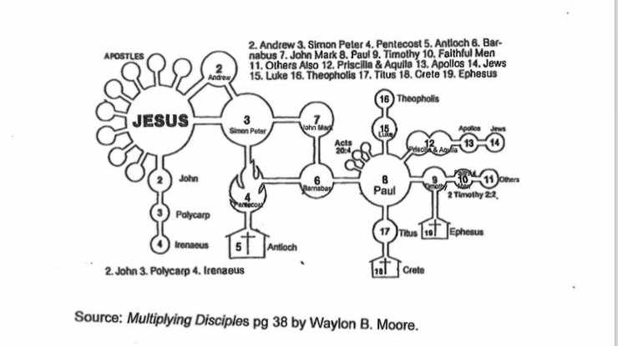
(a) CHAIN: PAUL → PRISCILLA/AQUILA → APOLLOS
CHAIN OF DISCIPLESHIP
(b) CHAIN: PAUL → EPHESIAN 12 → MOVEMENT

Slide 13
(c) BC CORE VALUE
REPRODUCE DISCIPLES
“I reproduce disciples who follow Jesus”
“Follow my example, as I follow the example of Christ” 1 Cor 11:1

Slide 14
3 STRATEGIES TO KEEP PREACHING. Acts 18-19
ADAPT YOUR METHOD,
NOT YOUR MESSAGE
Same Gospel…
Different Doorway
(i) People who claim to know the bible but resistant to follow Christ:
→ Scripture reasoning
(ii) Open seekers → Teach, laying biblical foundation
(iii) Those bound by false worship/false worship/spiritualism
→ Power encounters & public repentance

Slide 15
(b) EQUIP THE SAINTS
18 months in Corinth Acts 18:11
2+ years in Ephesus Acts 19:10
Growth = Systematic teaching & discipleship
Growth came from systematic teaching
Church, growth comes from making time to teach and disciple.

Slide 16
(c) FIND YOUR ‘TYRANNUS HALL’ Acts 19:8-10
From synagogue → Lecture Hall of Tyrannus
“Every day for 2 years” → _“all Asia heard”
Your ‘Tyrannus Hall’: Coffee shop, classroom, office, WhatsApp
Vision: “Do not be afraid, but go on speaking” Acts 18:9
Result: “The word... spread widely and grew in power” Acts 19:20

Slide 17

Application
Small Group Discussion
1. Identify your field: Which group are you reaching?
- People with Bible background but don’t know the Author
- Open seekers
- People bound by false worship, addiction, or darkness
2. How will you strategize witnessing to them?
3. Who can you disciple like Priscilla & Aquila?

