Slide 1
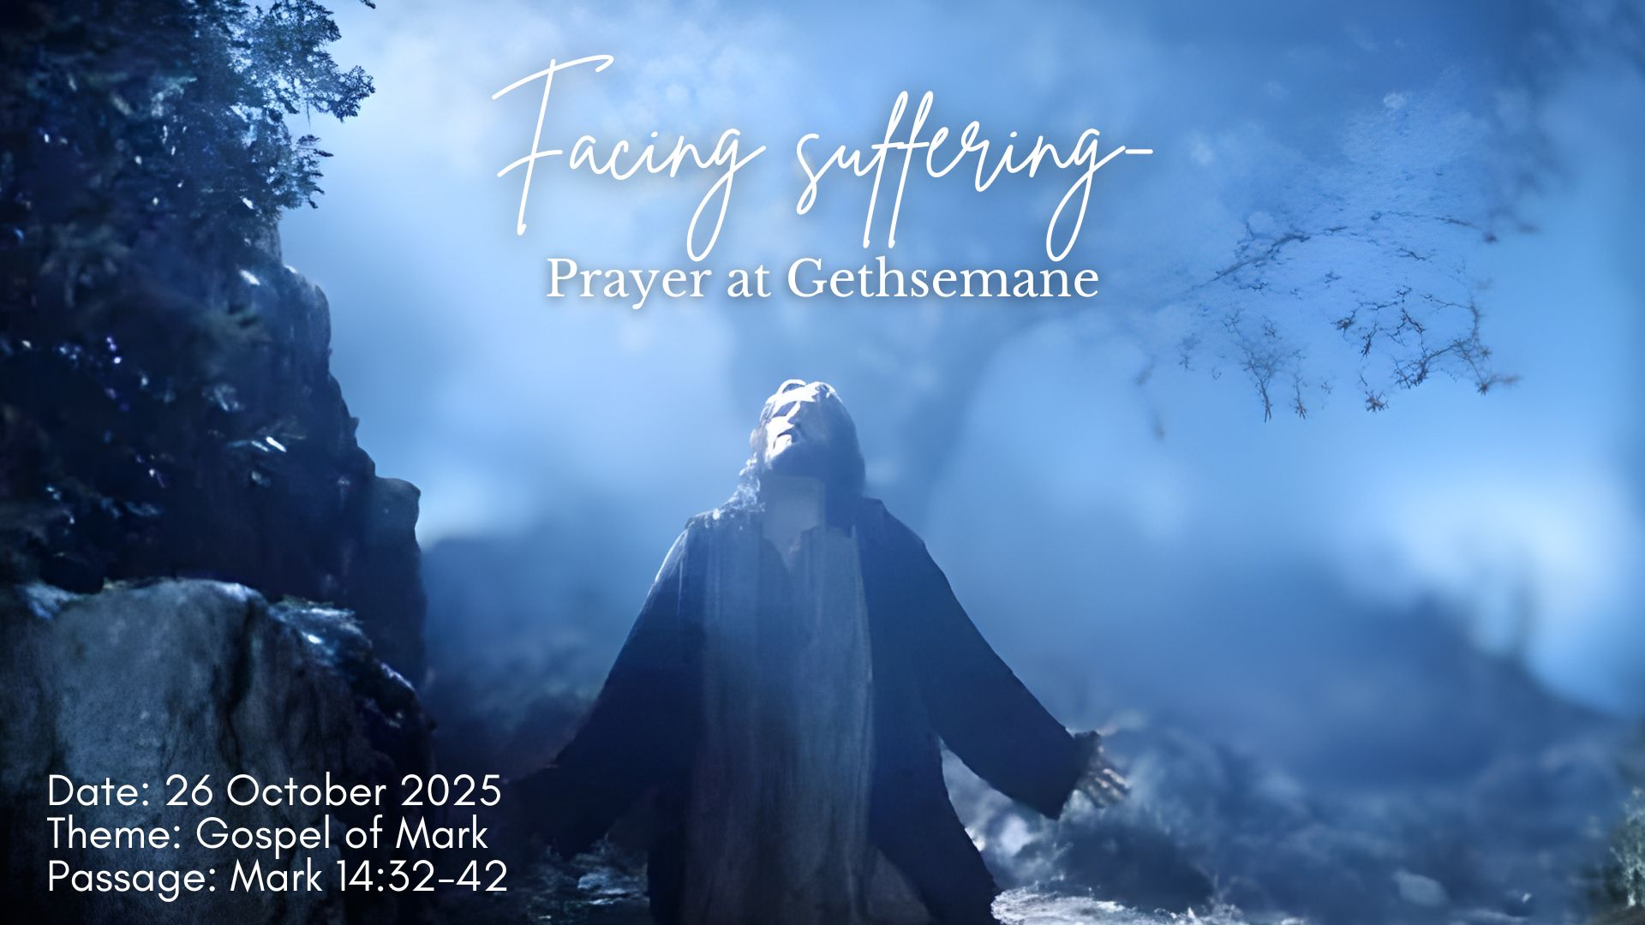

Slide 2
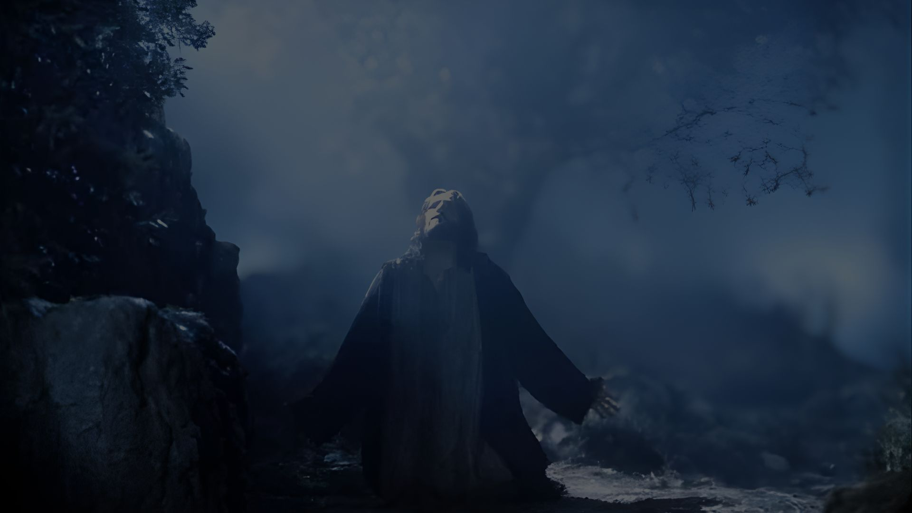

MARK 14
Gethsemane
³² They went to a place called Gethsemane, and Jesus said to his disciples, “Sit here while I pray.”
³³ He took Peter, James and John along with him, and he began to be deeply distressed and troubled.
³⁴ “My soul is overwhelmed with sorrow to the point of death,” he said to them. “Stay here and keep watch.”
³⁵ Going a little farther, he fell to the ground and prayed that if possible the hour might pass from him.
³⁶ “Abba, Father,” he said, “everything is possible for you. Take this cup from me. Yet not what I will, but what you will.”
³⁷ Then he returned to his disciples and found them sleeping. “Simon,” he said to Peter, “are you asleep? Couldn’t you keep watch for one hour?
³⁸ Watch and pray so that you will not fall into temptation. The spirit is willing, but the flesh is weak.”

Slide 3

Key Verse: MARK 14:36
MARK 14
³⁹ Once more he went away and prayed the same thing.
⁴⁰ When he came back, he again found them sleeping, because their eyes were heavy. They did not know what to say to him.
⁴¹ Returning the third time, he said to them, “Are you still sleeping and resting? Enough! The hour has come. Look, the Son of Man is delivered into the hands of sinners.
⁴² Rise! Let us go! Here comes my betrayer!”

Slide 4
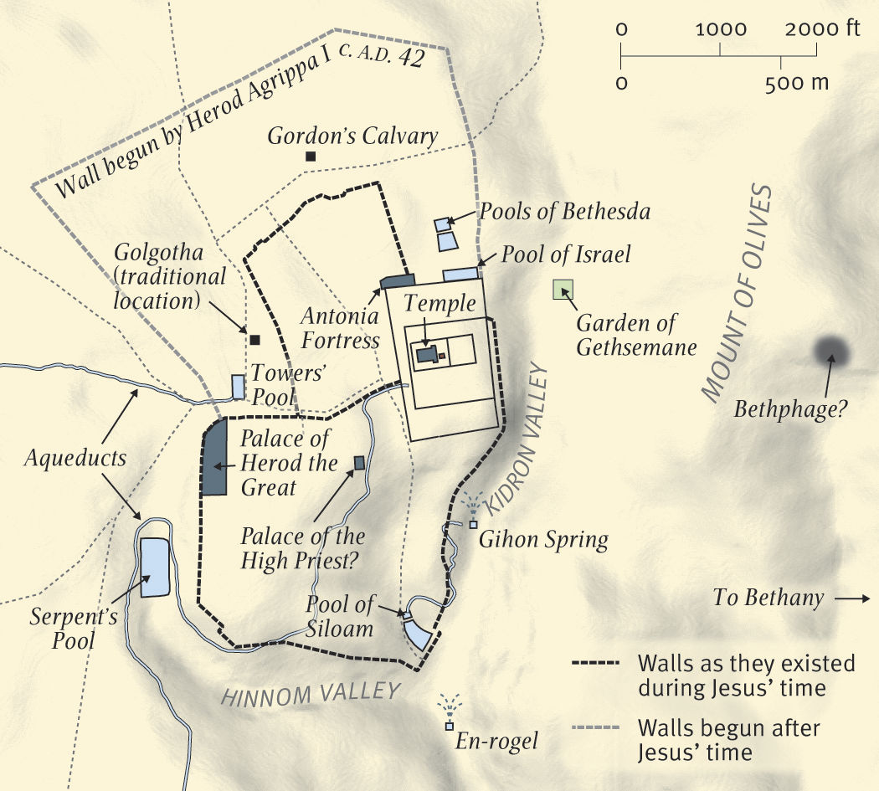
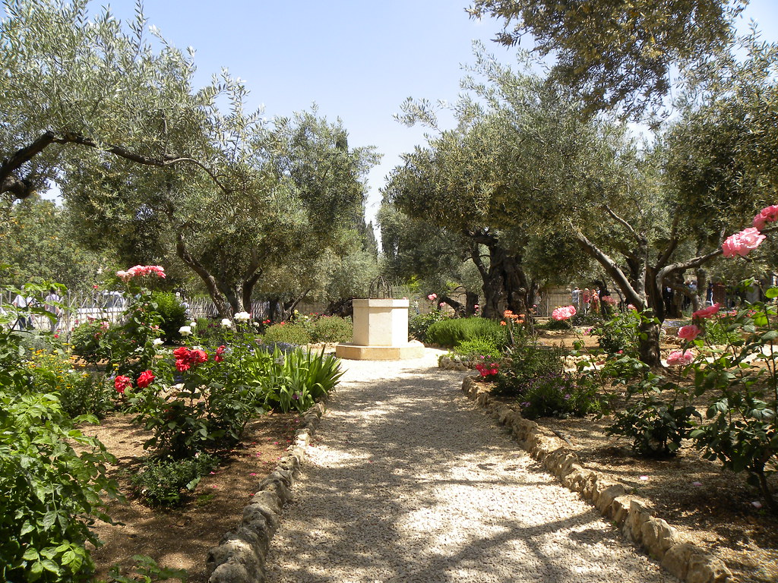
Mount of Olives
Garden of Gethsemane
^{Mark 14:34} “My soul is overwhelmed with sorrow to the point of death
Gethsemane (‘oil press’)
- Where love and sorrow meets
- Call to “Watch and Pray”

Slide 5
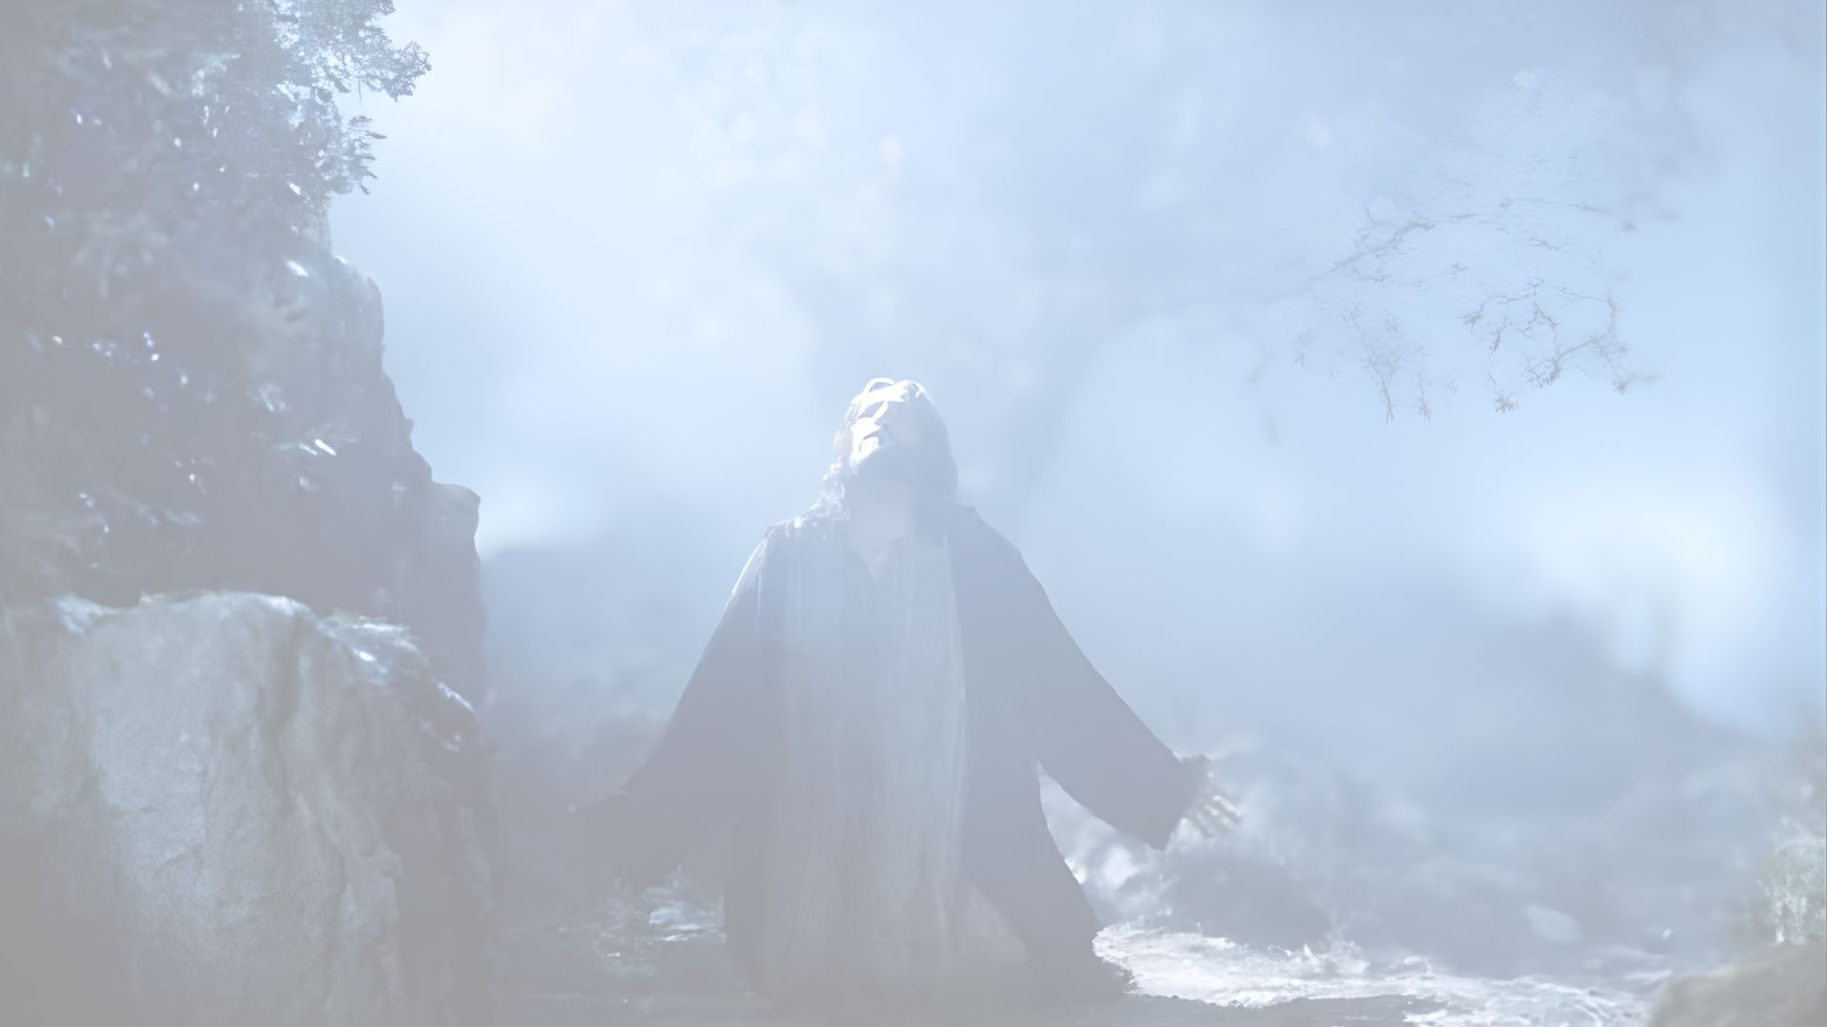
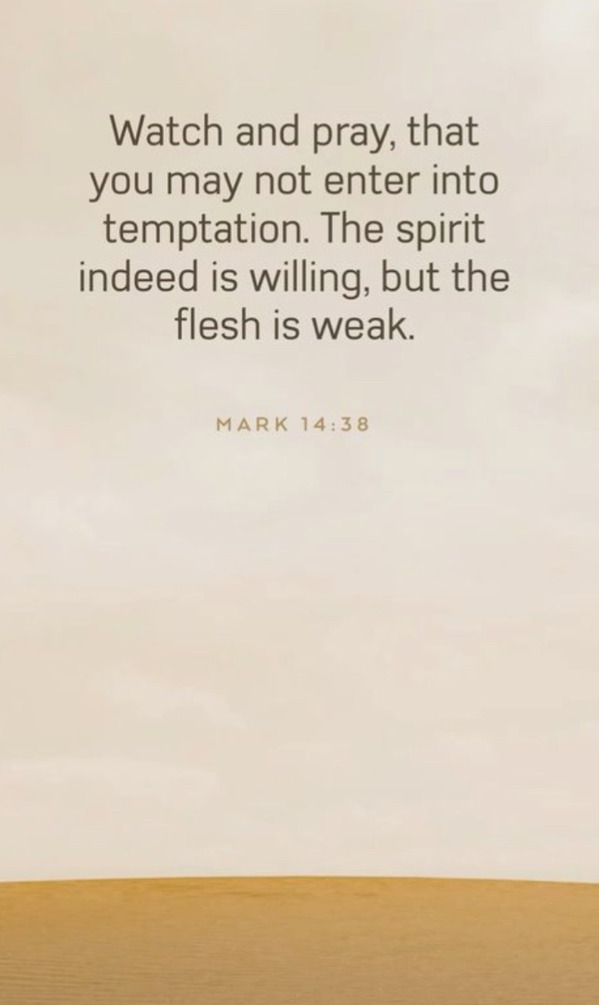
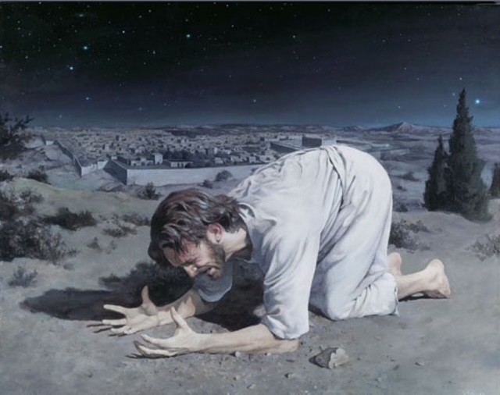
1(a) Jesus calls for spiritual vigilance
Jesus prioritises prayer in crisis:
Pray with Me
- Jesus tells His disciples, "Sit here while I pray" (v32
Stay Alert
- "Stay here and keep watch" (v34),
emphasizing the need for spiritual vigilance.
Watch and Pray
- so that you will not fall into temptation" (v38)
- highlights prayer to resist temptation.

Slide 6
Key Contrasts
Aspect | Jesus | Disciples
In a Crisis | Turns to prayer | Fall asleep
Emotional posture | Transparent and sorrowful | Passive and unaware
Prayer focus | Persistent and ‘surrendered’ | Distracted and disengaged
Call to action | ‘Watch & Pray’ | Fail to ‘Watch & Pray’
Outcome | Strengthened for obedience | Unprepared for coming trials

Slide 7
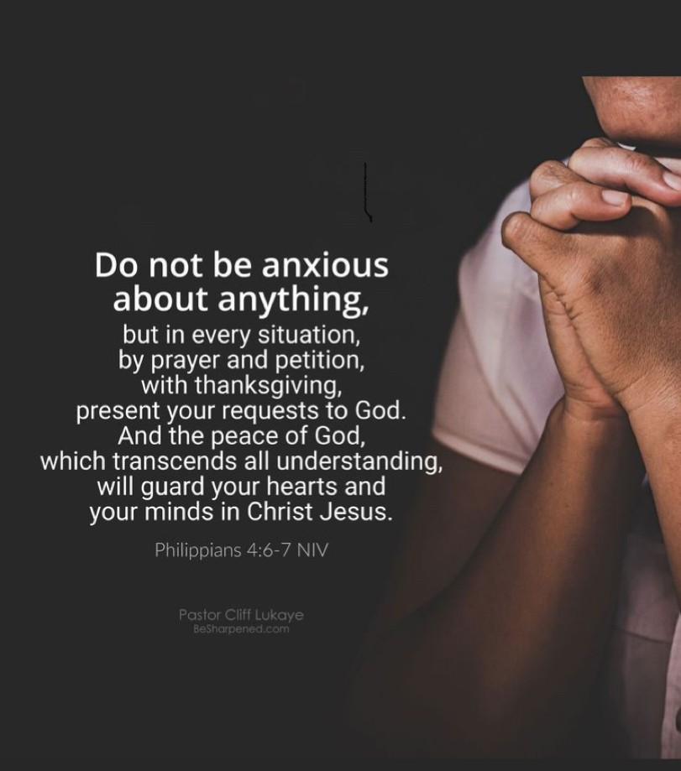
The call to every believer
In our moment of struggle and weakness, come … enter into prayer.
This moment in Gethsemane isn’t just for the disciples—it’s for us.
Jesus’ calls us to “watch and pray”
- In moments of sorrow, temptation, or decision
- Prayer is not optional. It is essential.
7

Slide 8

2. Jesus models how to face suffering
Three vital truths that Jesus models for us in Gethsemane:
(i) In Times of Sorrow, We Must Go to Prayer
(ii) We Must Pray to Overcome Temptation
(iii) We Must Pray to Receive Grace
8

Slide 9


2. Jesus models how to face suffering
(i) In Times of Sorrow, we Must Go to Prayer
Jesus was “deeply distressed and troubled.” He was “overwhelmed with sorrow to the point of death.” (Mark 14:33-34)
Yet in that crushing moment, Jesus didn’t run. He prayed.
“Abba, Father… everything is possible for You. Take this cup from Me. Yet not what I will, but what You will.”
(Mark 14:36)
9

Slide 10
2. Jesus models how to face suffering
(ii) We must pray to overcome temptation
“Could you not watch one hour? Watch and pray that you may not enter into temptation.”
(Mark 14:37)
Jesus had warned them:
“Pray that you will not fall into temptation.” (Luke 22:40)
- But they didn’t listen.
3 times He found them asleep
- And soon after, Peter would deny Him three times.
NO Prayer leads to NO Power!!
10

Slide 11

2. Jesus models how to face suffering
(iii) We must pray to receive grace
After Jesus prays, something shifts.
- He rises with authority:
“Rise! Let us go! Here comes my betrayer.”
(Mark 14:42)
When we surrender to the Father’s will, by the grace of God we come out victorious
- And God sent an angel to strengthen Him.
The disciples slept and failed when testing came
11

Slide 12
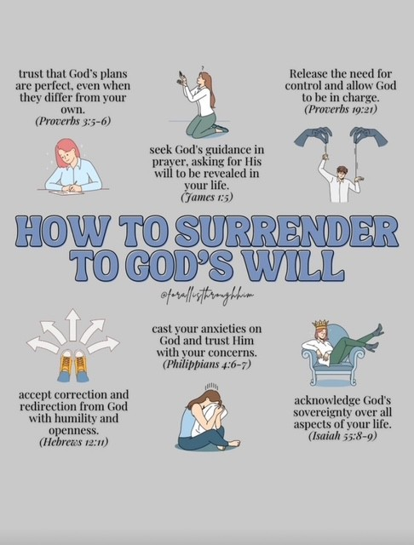

In sorrow?
- Pray.
In temptation?
- Pray to overcome
In weakness?
- Pray for grace.
Because the same God who met Jesus in the garden is ready to meet you.
What are you facing today?
- Is it sorrow? - Temptation?
- A decision that feels too heavy to carry?
Then go to Gethsemane.
- Not just to observe Jesus but to follow Him.

Slide 13
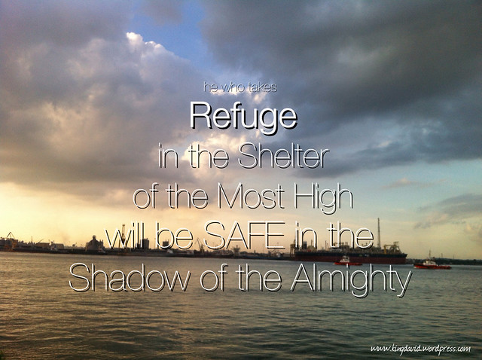
My Testimony
2 Chronicles 20:17
“You will not have to fight this battle. Take up your positions; stand firm and see the deliverance the LORD will give you… Do not be afraid; do not be discouraged.”
Jeremiah 39:17-18 assured me:
“I will rescue you… you will not be given into the hands of those you fear.”

Slide 14
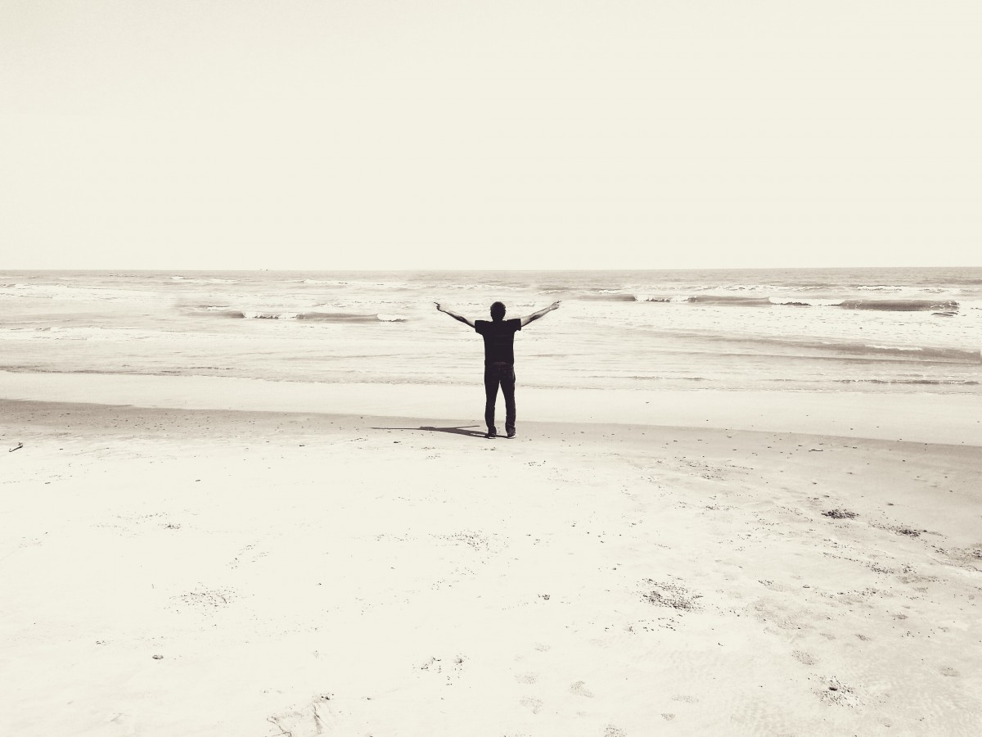
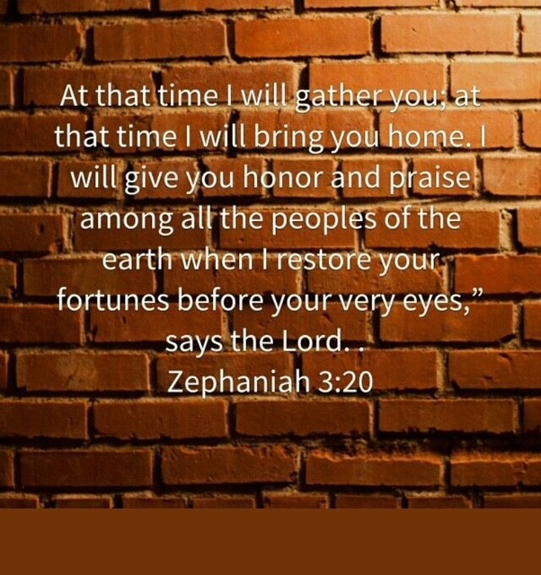
My Testimony

Slide 15

3. “Watch and Pray” in the End Times
“Watch and pray so that you will not fall into temptation.”
(Mark 14:38)
Jesus is saying to us today:
Don’t be found sleeping
Scripture repeats this call:
“Watch out that no one deceives you.” (Matthew 24:4)
“Keep watch, because you do not know the day or the hour.” (Matthew 25:13)
“Be on guard! Be alert!” (Mark 13:33)
“Be always on the watch, and pray.” (Luke 21:36)
“Blessed is the one who stays awake.” (Revelation 16:15)
.
15

Slide 16
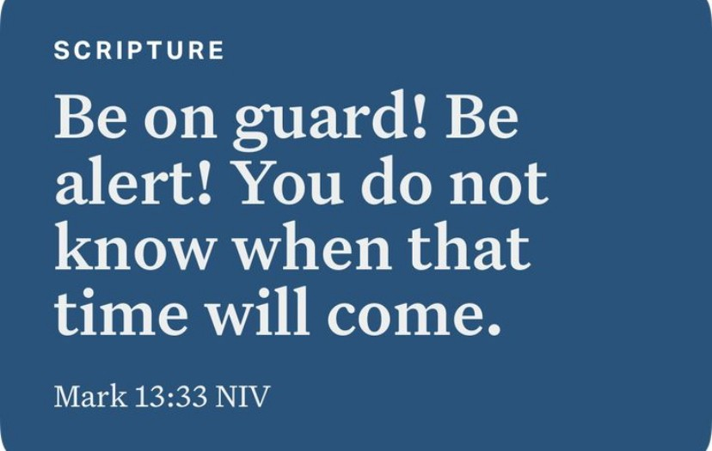
3(b) Three key takeaways for navigating the End Times
Stay spiritually alert – Together in corporate prayer
Jesus commands in Mark 13:33:
Hebrews 10:24–25 urges us to “encourage one another… and all the more as you see the Day approaching.”
The word “see” implies active, ongoing watchfulness—alert to deception, temptation, and spiritual danger.
16

Slide 17
3(b) Three key takeaways for navigating the End Times
Pray persistently and seek God’s will
“Praying at all times in the Spirit… keep alert with all perseverance.”
(Ephesians 6:18)
Jesus didn’t just pray for relief –
He prayed for surrender:
“Not what I will, but what You will.”
(Mark 14:36)

Slide 18
3(b) Three key takeaways for navigating the End Times
Like Jesus in Gethsemane, we watch and pray—not with fear, but with purpose and dependence on God.
“Be watchful, and strengthen the things which remain… hold fast and repent. Therefore if you will not watch, I will come upon you as a thief, and you will not know what hour I will come upon you. ”
(Revelation 3:2-3)
18

Slide 19

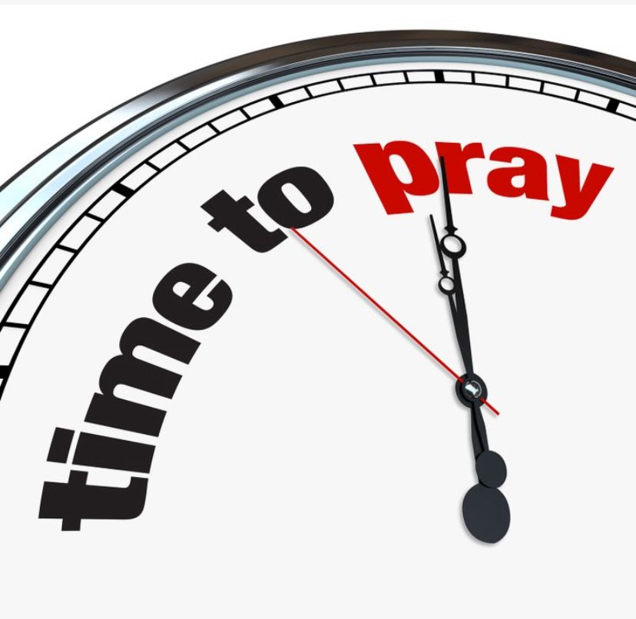

Prayer

Slide 20
Application
1. What does Jesus’ honesty in prayer at Gethsemane teach us about how we can approach God in our own moments of sorrow or fear?
[Consider how Jesus expressed His emotions and desires without holding back.]
2. What area of your life needs a Gethsemane prayer today?
could you say, “Not my will but Yours be done…”?
[Spend a moment to reflect on para #2 and make plans to engage in this prayer in your ‘garden of Gethsemane’]
3. In what areas of your life do you feel ‘spiritually asleep’, and how can prayer help you stay alert and aligned with God’s purpose?
[Think about Jesus’ warning to “watch and pray” and how it applies to the “Day of His coming in the clouds”?]

